Slide 1
MUNICIPALITY OF KURSUMLIJA

Slide 2
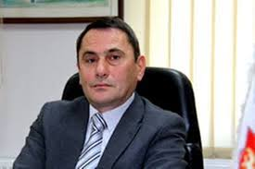
GREETINGS FROM THE MAYOR
Dears investors,
I would like to invite you cordially to our beautiful city. Kursumlija has the ambition to become “a city for the whole of life” for all those who love this place and would like to invest in our municipality. Extremely favorable natural conditions, educated and cost-competitive workforce, a favorable geographical position and numerous incentives for investors provide an opportunity to realize this vision.
The self-government of the municipality of Kursumlija is a reliable partner for potential investors coming to our municipality. We are ready to be your partner in achieving business desires, plans, ambitions, partners in the realization of new jobs and creation of new values We help all the entrepreneurs and investors to make contacts with the local associations, clusters, chambers of commerce and other relevant organizations, but also with private companies.
You are cordially welcome.
Radoljub Vidic, dipl. ecc.

Slide 3
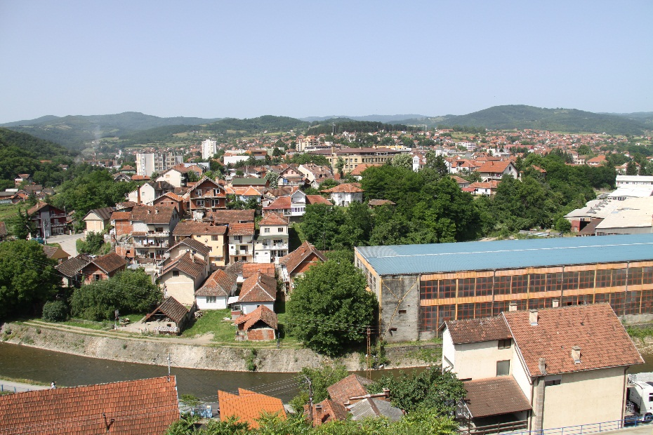
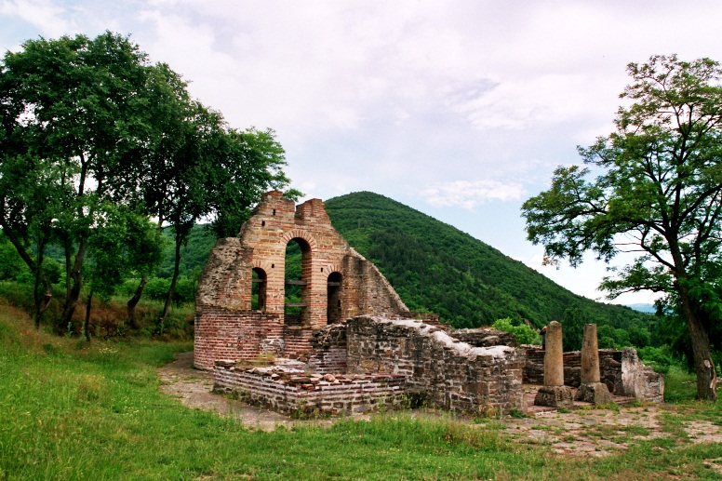
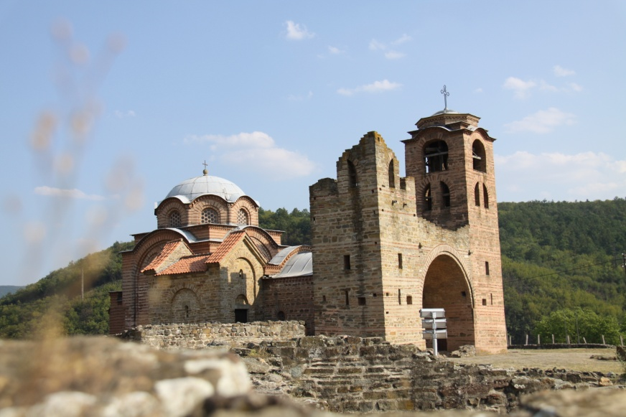
The Municipality of Kursumlija – importance and facts: Kursumlija is located near the rivers Toplica, Kosanica and Banjska, on the southeast of mount Kopaonik and northwest of mount Radan
Total area: 952 km2
Population: 19 011 (2011 census) in 90 settelments
Population density: 19 people per km2
Neighboring cities: Brus, Blace, Prokluplje, Medvedja and Leposavic

Slide 4
STRUCTURE OF UNEMPLOYED POPULATION
 | Men | Women
I | 545 | 575
II | 20 | 15
III | 415 | 293
IV | 458 | 552
V | 6 | 3
VI | 46 | 88
VII | 66 | 101
VIII | 0 | 0
I+II | 565 | 590
III-VIII | 991 | 1037
Укупно: | 1556 | 1627
The total number of unemployed population in 2015: 3 183 people
The ultimate goal of the city is to build and sustain commercial infrastructure and to create the job opportunities for the people from the region.
Therefore it is important to build up a stable business environment in order to encourage and attract foreign investors to set up businesses in the city.
Table 1: Number and structure of unemployed in the municipality of Kursumlija in 2015

Slide 5
INVESTMENT INCENTIVES
FAST REGISTRATION OF COMPANY
THE NATIONAL EMPLOYMENT SERVICE GRANTS
FINANCIAL BENEFITS AND INCENTIVES
TAX INCENTIVES
TRADE AGREEMENT

Slide 6
REGISTRATION OF COMPANY
One-Stop-Shop Registration System
The procedure of incorporation of companies is provided through a one-stop-shop registration system that enables the concurrent issuance of the registration number, tax identification number and healthcare insurance number to each company registering with the Serbian Business Registers Agency.
Where: Serbian Business Registers Agency (www.apr.gov.rs)
Founding capital: 1 euro
Number of days needed for registration of company: 5 days
Procedure for establishing a company or entrepreneurial activities
A unique registration application for the establishment of business entity
Supporting documentation
Proof of payment of the fee

Slide 7
THE NATIONAL EMPLOYMENT SERVICE GRANTS
The National Employment Service (NES) grants include:
1. the Employment Subsidies Program,
2. the Apprentice Program, and
3. the Re-Training Program.
Source: National Employment Service

Slide 8
FINANCIAL BENEFITS AND INCENTIVES
STATE GRANTS
Types of incentives that can be allocated:
Create at least 20 jobs and a minimum of EUR 150,000 of the eligible costs of investment in units of local government that are classified in the IV group of development and the devastated areas
Incentives for eligible costs of gross salaries for new jobs – 40% and 7.000 euros per new job created (for devastated regions).
Incentives for eligible investment costs in fixed assets – 30%
Additional incentives for labor-intensive projects
The funds may be awarded for financing investment projects in the manufacturing sector and the services sector which may be subject to international trade
Kursumlija belongs to the circle of least developed municipalities in Serbia (devastated area) and has the status of the first rank priorities in the development policy of the Republic of Serbia.
Accordingly, we recommend special incentives that apply to the category of devastated areas (below 60% of the national average).

Slide 9
FINANCIAL BENEFITS AND INCENTIVES
Eligible costs
are investments in tangible and intangible assets, as of the date of signing of the grant agreement until the deadline for implementation of the investment project,
costs of gross salaries for new jobs created
Leasing of business premises are taken into account as an eligible investment costs in which the investment project is implemented

Slide 10
TAX INCENTIVES
Serbia`s favorable business environment features highly competitive tax rates and low operating costs.
Corporate Profit Tax– 15%
Taxes on dividends, shares in profits, royalties, interest and capital gains – 20%
– VAT standard rate 20%
- VAT reduced rate 10%
The rates for mandatory social security contributions are:
14% for pension and disability insurance,
5.15% for health insurance, and
0.75% for unemployment insurance.
Source: National IPA, 2015

Slide 11
TAX INCENTIVES
Corporate profit tax holiday
Carryinf forward and losses
Avoiding double taxation
Reduced salary load
Annual income tax deducations
Custom-free imports of raw materials and semi finished goods
Custom-free imports of machinery and equipment

Slide 12
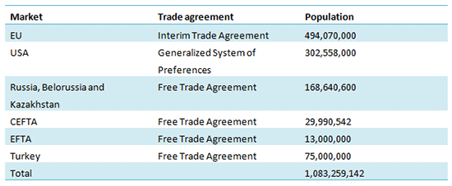
TRADE AGREEMENT
European Union
Russian Federation
CEFTA
United States of America
Turkey
EFTA
Kazakhstan
Belarus
Source: Development Agency of Serbia

Slide 13
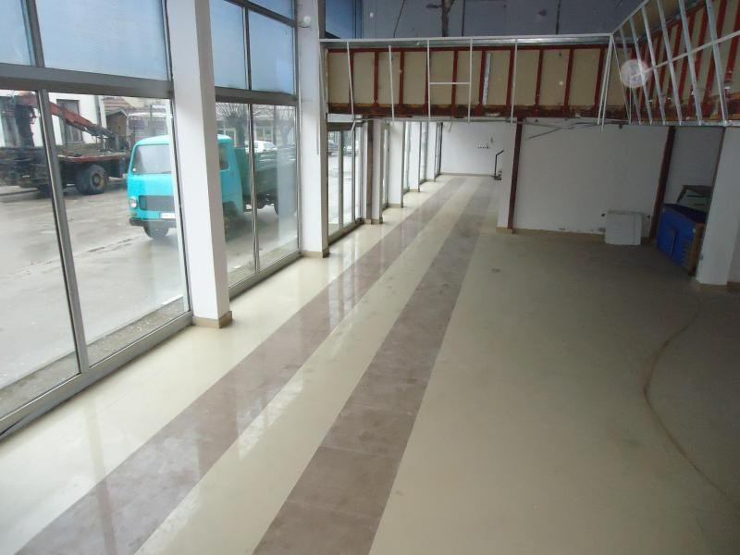
BRAUNFIELD LOCATIONS
МК „7. Juli“, Kursumlija
Ownership status: State ownership
Address: Kosovska, Kursumlija
Total land area(m2): 4520
Total buildings area (m2): 6935
Purpose: Rent
Additional information:
http://serbia-locations.rs/locations-srb/location.php?ID=722

Slide 14
BRAUNFIELD LOCATIONS
Metalac Company, Kursumlija
Sawmill Dobri Do, Kursumlija
Ownership status: Private ownership
Address: Milutina Uskokovica bb
Purpose: Rent
Object name: Hall Metalostrugar
Total building area(m2): 1790
Additional information:
http://serbia-locations.rs/locations-srb/location.php?ID=75
Ownership status: Private ownership
Location: village Dobri Do
Total land area (m2): 4964
Additional information:
http://serbia-locations.rs/locations-srb/location.php?ID=230

Slide 15
Municipality of Kursumlija
Proleterskih brigada bb, 18430 Kursumlija, Serbia
Phone: + 381 (0) 27 381 383
E-mail: info@kursumlija.org
Internet page: www.kursumlija.org

